Slide 1
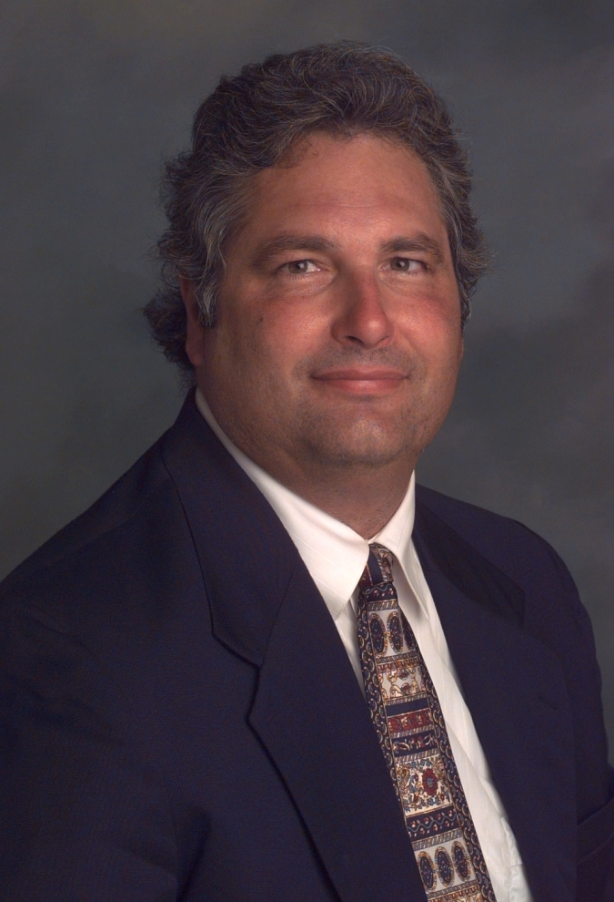
Data Science in L.A.'s “Silicon Beach”: Shadow Vocation or Emergent Profession?
2015 CSU-POM Conference
CSU Northridge
28 February 2015
Wayne Smith, Ph.D.
Department of Management
CSU Northridge
ws@csun.edu
This PPT is available at:
smithw.org/csupom.pdf or github.com/wsphd/csupom/

Slide 2
Motivation
Background/Preliminaries
I apologize…
“cloud computing”, “big data”, “marketing analytics”, and worse of all, “data science”
These are industry “terms”, not ours
I prefer decision-support systems, predictive modeling, statistical computing, and mathematical optimization, but most of the folks I routinely work with prefer the term “data science” (I suppose we might agree on the terms analytics and visualization.)
I am on the steering committee for the LA R/Data science Meetup group
There are a few other Ph.D.s heavily involved too—Szilard Pafka (primary), David McArthur, Rob Gould, Jeremy Miles, Tim Triche, Eduardo Arino de la Rubia, and others
Opportunities and Challenges
Is there a perturbation (disequilibrium) in this labor market?
What should be our institutional role (if any) in this community?
Are we witnessing the emergence of a new data guild in the service economy?

Slide 3
Candidate Explanations (1/2)
Behavioral Economics
“Extreme Discounting”
“I am deliberately overweighting of short-term preferences and underweighting of long-term goals.”
Finance
“Loan-to-Value”
“I might not achieve my potential, but at least I’m not in debt.”
Statistics (inference)
Privilege specification (narrow results) over generalization (broader theory development)
“If I have more data, then I have proportionally more information.”
Computer Science (machine learning)
Demonstrated capability with the current (“right now”) platforms and languages is the valued skill.
“I need Bayesian approaches for large “samples”, not frequentist approach for small samples.”

Slide 4
Candidate Explanations (2/2)
Psychology
“You don’t know me!”
“The UC, CSU, and CCC’s teach mostly theories and I mostly just learn how to write papers there.”
Education
“I don’t need general education and extra-curriculars; I need just-in-time education (for life).”
“I need just-in-time theories for my practice (to answer the boss’ questions for next week).”
Political Science
“Help! I’m scared and confused about the future and my role in it!”
“If I don’t take this job, someone with an H1-B visa might.”
Historiography
“Merchant-Craftsmen” and “Craft Guilds” (apprentice, journeyman, master)
“Trades[men] and crafts[men] have always created local, persistent, supportive communities.”

Slide 5
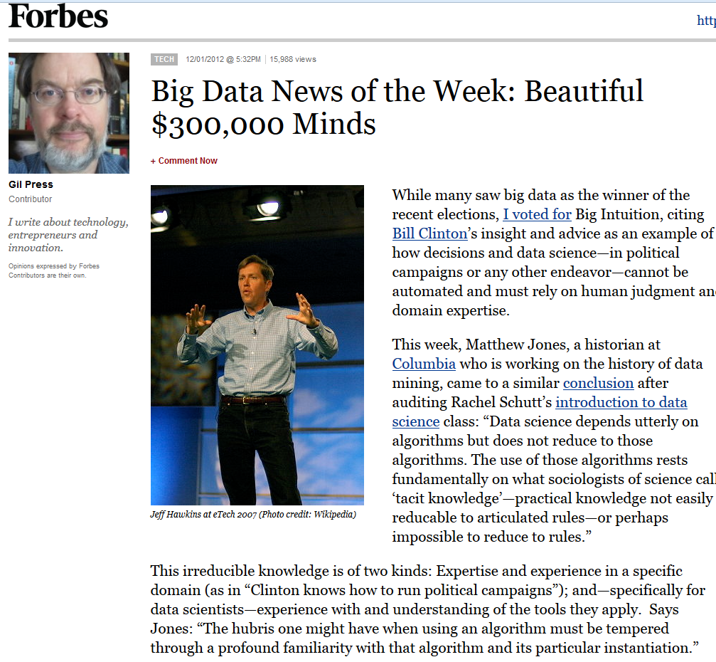

Slide 6
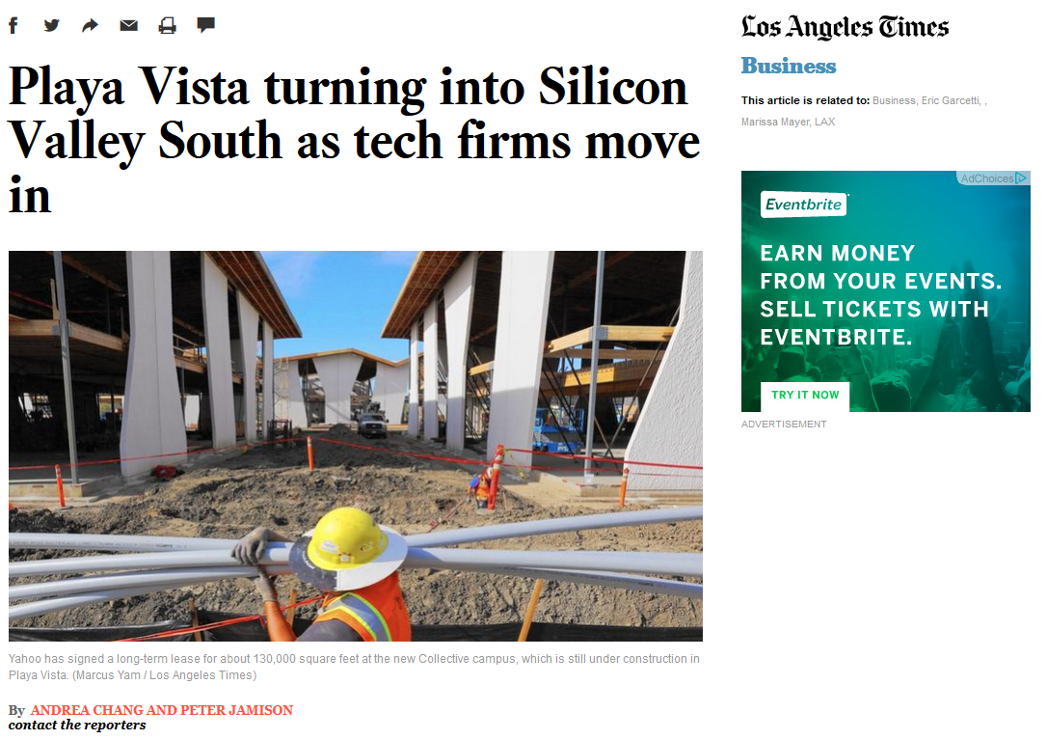
http://www.latimes.com/business/la-fi-silicon-valley-south-20150118-story.html#page=1

Slide 7
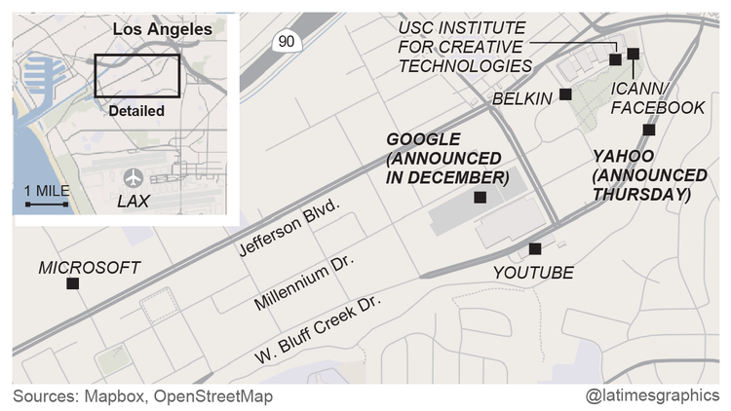

Slide 8
Coordination
Monthly Meetups (physical, not virtual)
E.g., www.datascience.la
Monthly meetings (50-200 people)
By language/platform/environment: R, Python
By technology/workflow: Visualization, DW/BI, Machine Learning
By sector/domain: AdTech, FinTech
By management “level”: a few directors- and mangers-only events (by invitation only)
Annual Conferences (physical, not virtual)
E.g., “Big Data camp” at Direct TV (El Segundo)
http://insidebigdata.com/2014/06/03/free-conference-big-data-camp-2014/
Multiple, parallel tracks
Vendor support (all expenses covered fully)
Last three years’ attendance—200 (2013), 500 (2014), 800 expected (2015)

Slide 9
R and/or other tools
COTS (Non-FOSS)
SAS, IBM SPSS, Stata, S-PLUS, BMDP, Lisrel, EQS, HLM, MPLUS, SmartPLS, …
Mathematica, @Risk, Excel add-ins, RATS, Matlab, Simscript, Arena, etc.
IBM Netezza, MS Anal. Srv., Oracle Adv. Anal., Teradata Miner, etc.
UCINET/NVivo/Tropes, ConQuest, ArcGIS, etc.
IBM CPLEX, MOSEK, GUROBI, Frontline, etc.
FOSS/GNU
Domain-specific?
GRETL/xBUGS, Ggobi, Pajek, lisp-stat, Netlib/BLAS/LAPACK/FFTPACK, etc.
Sage, octave, Scilab, Java/Colt/JFreeCharts, incanter, Protovis, D3, etc.
GNU LP, COIN-OR, NASTRAN/BLAS, NETLIB, WordNet, statconn, etc.
General-purpose?
jQuery/jqueryUI/flot/jstat, BIRT, RapidMiner, Pentaho, etc.
Apache Solr/Hadoop/Spark/Lucene/OpenNLP/Mahout/Velocity, etc.
Python ― iPython/NumPy/matplotlib/statmodels/Blaze/Bokeh/scikit-learn, etc.
Julia ― iJulia/Juno/MultivariateStats/MLBase/TimeSeries/Gadfly/JuMP, etc.

Slide 10
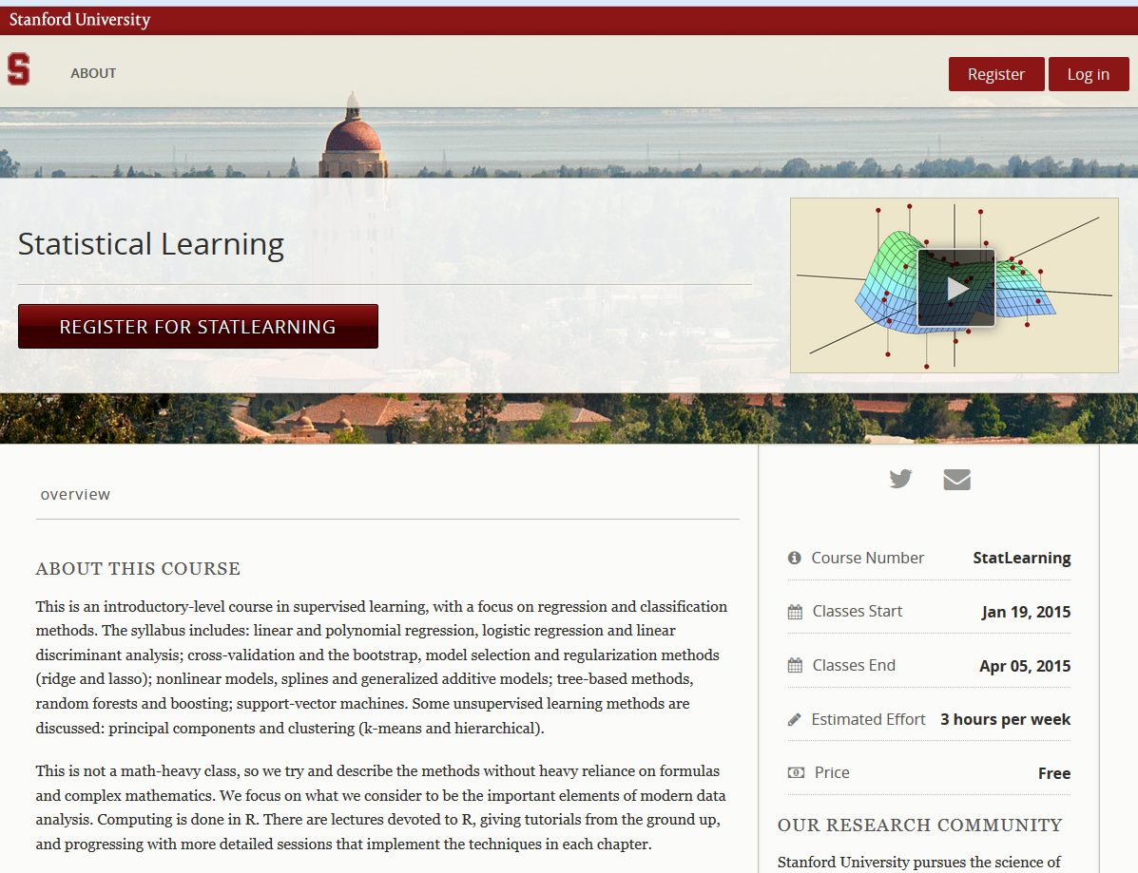

Slide 11
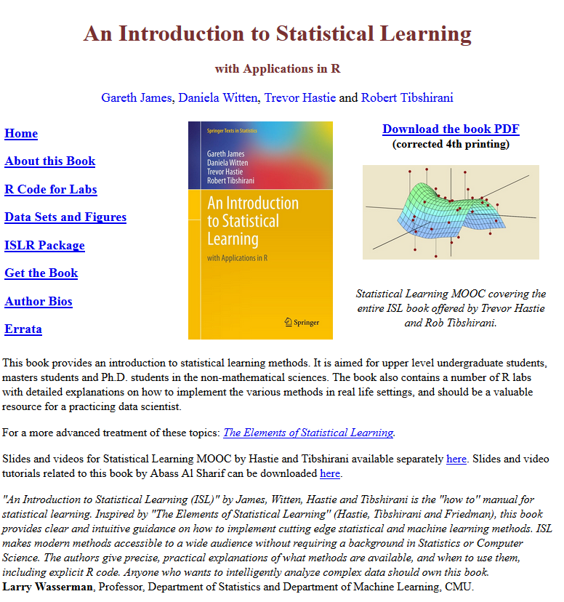

Slide 12
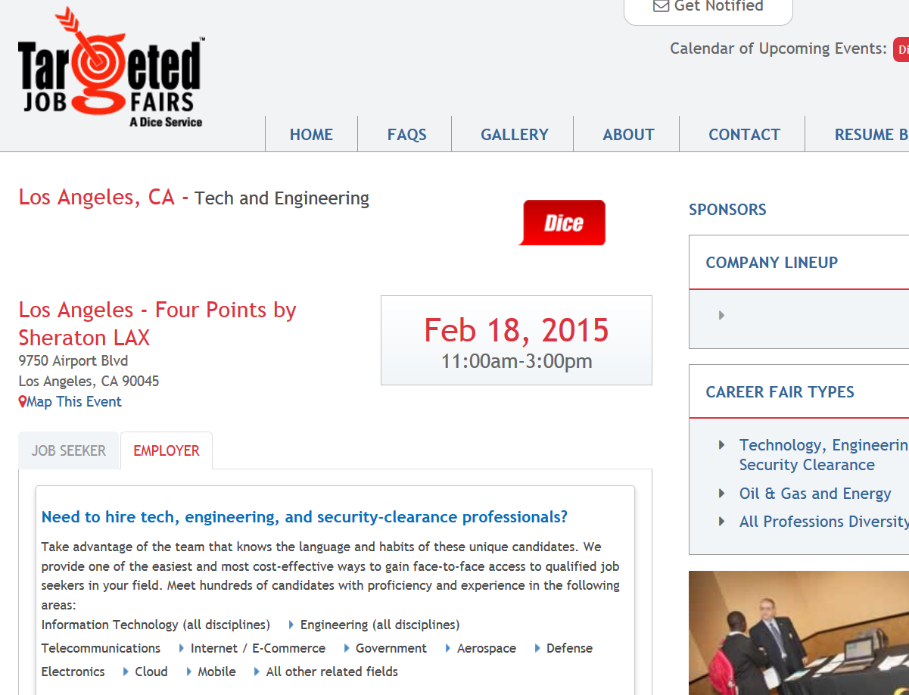

Slide 13
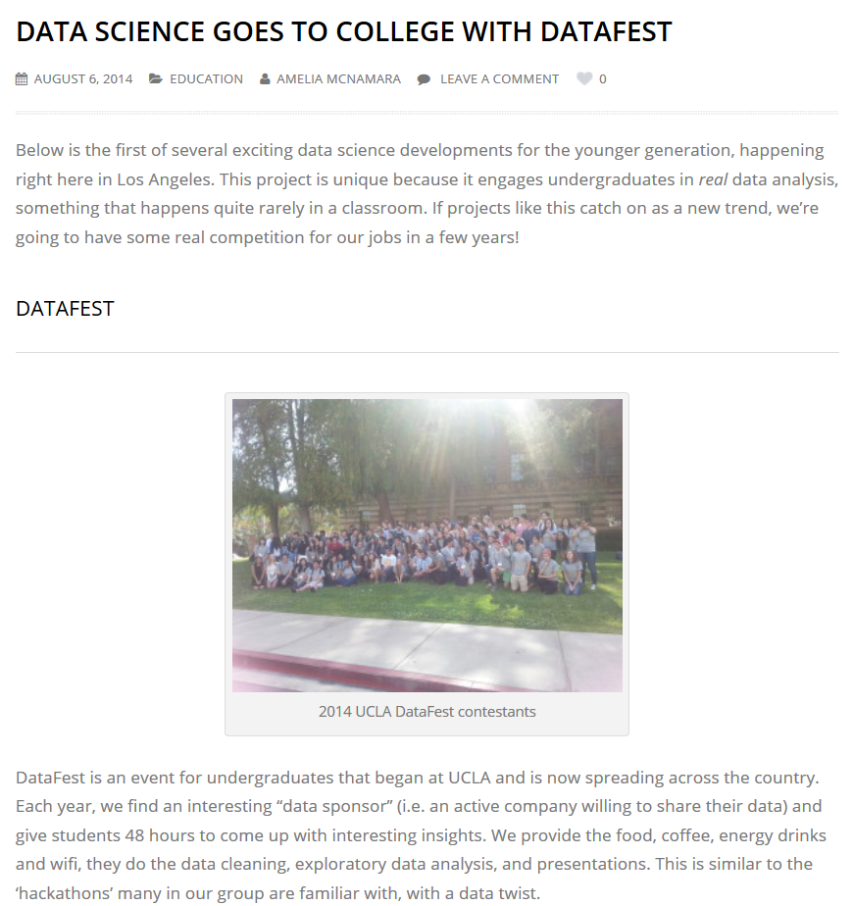

Slide 14
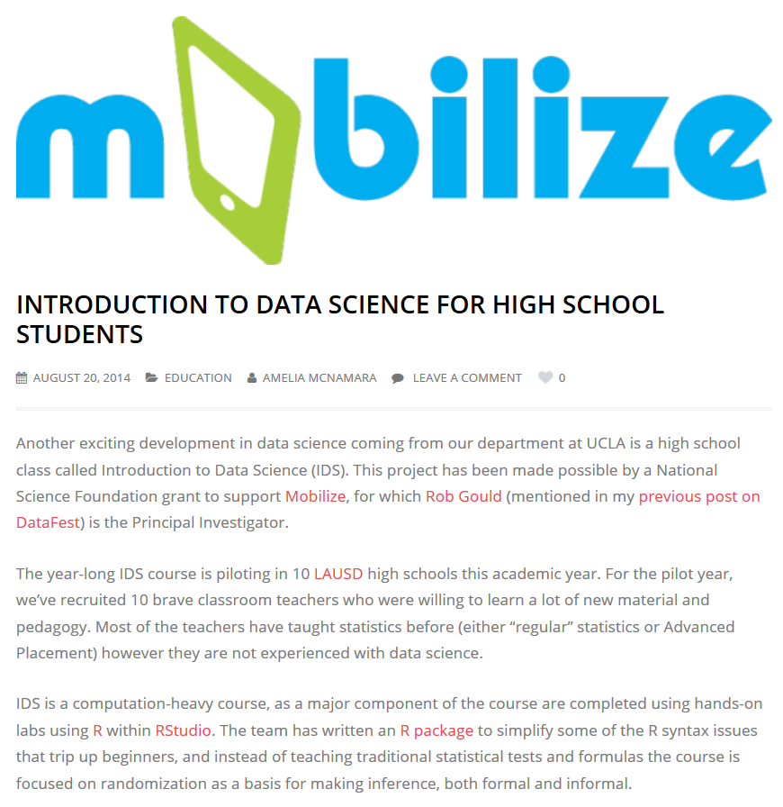

Slide 15
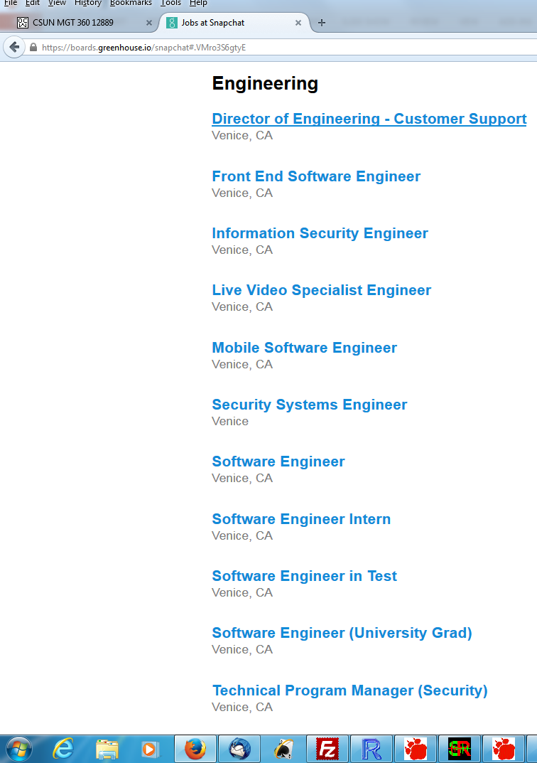

Slide 16
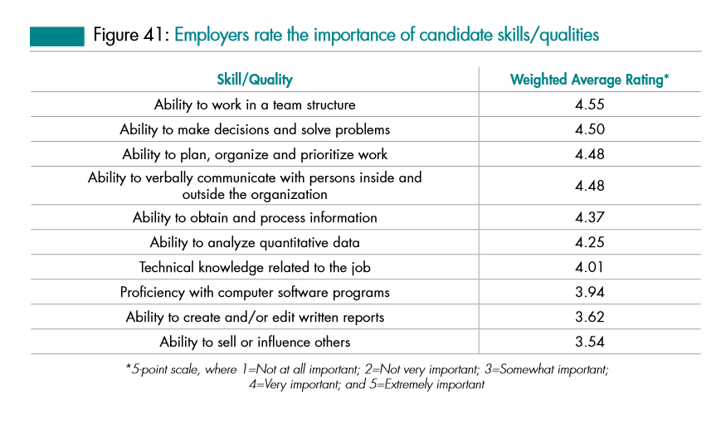
Relative importance of “data science”
Source: Job Outlook 2014, National Association of College and Employers

Slide 17
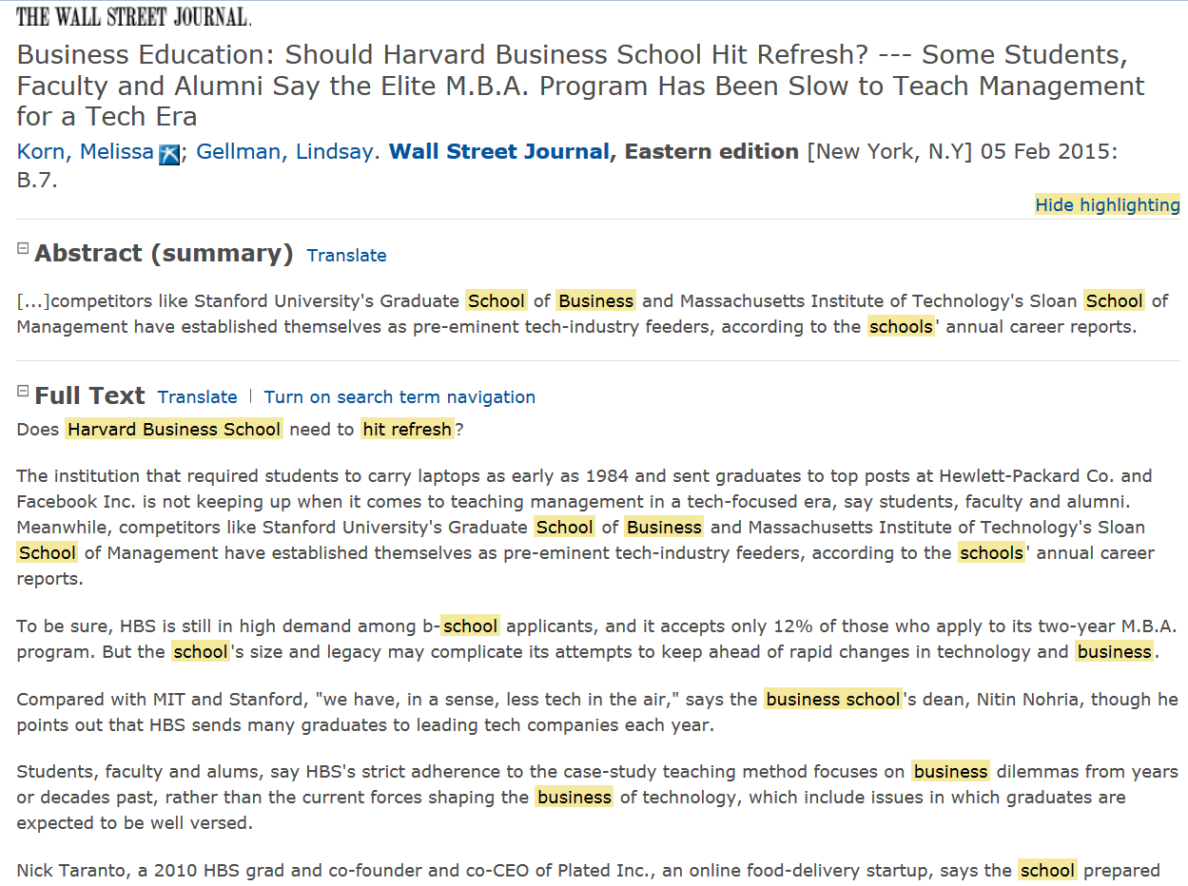

Slide 18
4-year Schools in this New “Service” Economy in CA?
USC, M.S. (part of the C.S. Dept.)
http://www.cs.usc.edu/academics/masters/msdata.htm
UCI Extension, certificate
http://unex.uci.edu/areas/it/data_science/
UC Berkeley, M.S. (online) (part of the School of Information)
http://datascience.berkeley.edu/
CSU Fullerton, certificate, online, accelerated
http://extension.fullerton.edu/professionaldevelopment/certificates/data-science
Is undergraduate appropriate?
Is CSU (mainstream) appropriate?
Other approaches/ideas?

Slide 19
CCC’s in this New “Service” Economy?
15 CA Community Colleges will offer Bachelor’s Degrees beginning in 2017.
Airframe manufacturing technology, Antelope Valley College
Industrial automation, Bakersfield College
Emergency services and allied health systems, Crafton Hills College
Mortuary science, Cypress College
Equine industry, Feather River College
Dental hygiene, Foothill College and West Los Angeles College
Bio-manufacturing, Mira Costa College
Respiratory care, Modesto Junior College and Skyline College
Automotive technology, Rio Hondo College
Health information management, Mesa College
Occupational studies, Santa Ana College
Interaction design, Santa Monica College
Health information management, Shasta College

Slide 20
Open Questions
Is this observation an itinerant, ephemeral fad or a persistent structure?
Is this eco-system geographic-specific or due to its virtual nature, widespread?
Vis-à-vis other paid work, is this type of work off-shorable over time?
If this sector is indeed growing, is it still just a small part of the economy anyway?
Is this phenomenon (like some other aspects of IT) gender-skewed?
Does the evidence suggest privileging competencies over degrees?
Is my experience with these “professionals”, ultimately, the triumph of practice over theory (as seen from the perspective of a prospective, potentially confused soon-to-be-in-some-debt-from-a-student-loan CSU student)?

Slide 21
Open Questions
Without college degrees, how will these “data scientists” eventually lead/be ethical/well-rounded, etc. over a 40-year career arc?
Licensing? Certifications? “Badges”?
How will they get promoted?
Can they can just enroll into holistic B.S./B.A. (pre-M.S./M.B.A.) programs later in life?
If applied math, computer science, statistics, and business were all individual degrees before, then how could we possibly make a single “data science” degree (all of them together) now?
What is the role of Ph.D.’s and academics (other than paid consulting)?
If we help (e.g., lectures, provide experts, networking, etc.), are we, in fact, directly or inadvertently helping young folks not go to College?
What do we tell our Deans and Provosts about our deep involvement with individuals who aren’t in going to college?
Isn’t this phenomenon, if evident, just a new version of (yet one more) vocation?
The CSU, as one component of the CA Master Plan, doesn’t “train” individuals (non-professionals) into vocations. We “educate” individuals for broader success.
Does any of this matter to our programs in either the short-run or long-run?
Your thoughts?

Slide 22
Further Reading
Davenport, T., and Patil, D. J. (2012), “Data Scientist: The Sexiest Job of the 21st Century”, Harvard Business Review, October.
History of the Organization of Work
http://www.britannica.com/print/topic/648000
Los Angeles Economic Development Corporation
High Tech in LA (October, 2014)
http://laedc.org/wp-content/uploads/2014/10/High-Tech-in-LA_20141006_FF.pdf
McAfee, A., and Brynjolfsson, E. (2012), “Big Data: The Management Revolution”, Harvard Business Review, October.

Slide 23
Further Reading
Journals:
Journal of Data Science
Data, dikw, big data and data science
“Academic” Conferences
INFORMS Big Data conference (April, 2015) (Huntington Beach, CA)
http://meetings2.informs.org/wordpress/analytics2015/
ACM SIGMOD “Management of Data” conf. (May/June, 2015) (Melborne, VIC, AU)
http://www.sigmod2015.org/
“Practice” Conferences
TDWI Big Data conference (February, 2015) (Las Vegas, NV)
http://meetings2.informs.org/wordpress/analytics2015/
Periodicals
Analytics Magazine
http://www.analytics-magazine.org/

